Slide 1
3D Ecosystem
Media art 206 Final presentation
Zixu Geng
zg73

Slide 2
Simulate an Ecosystem with producer and consumer
The goal
How environment change effects population
How the features of biological effects population

Slide 3
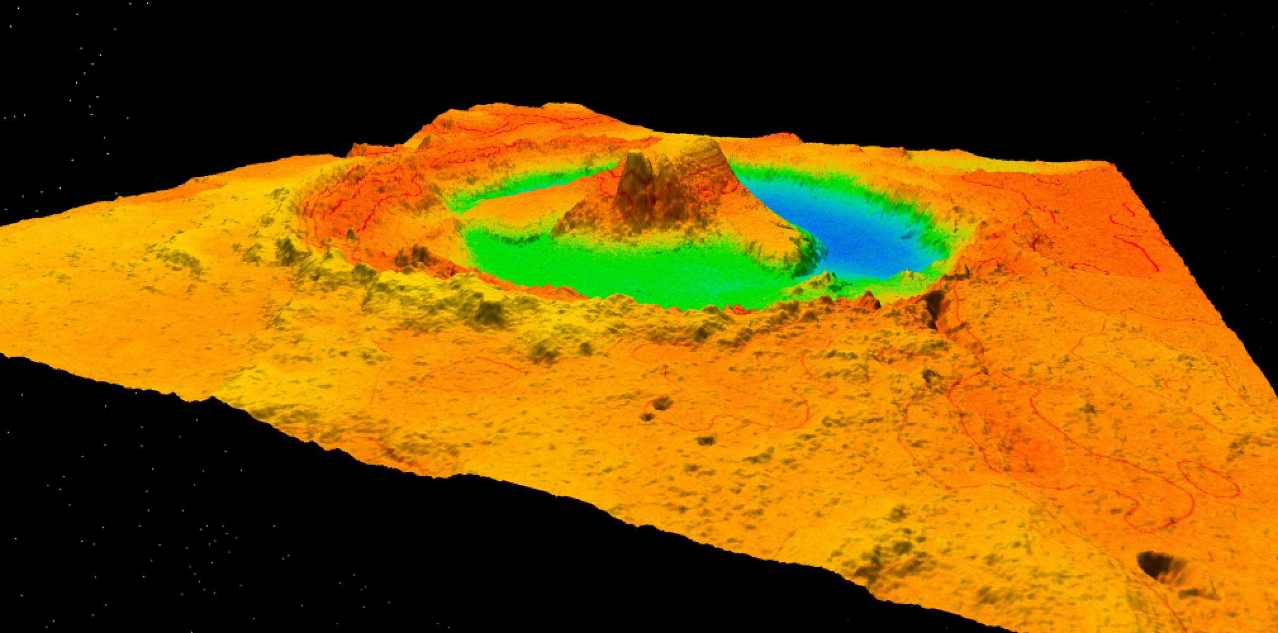
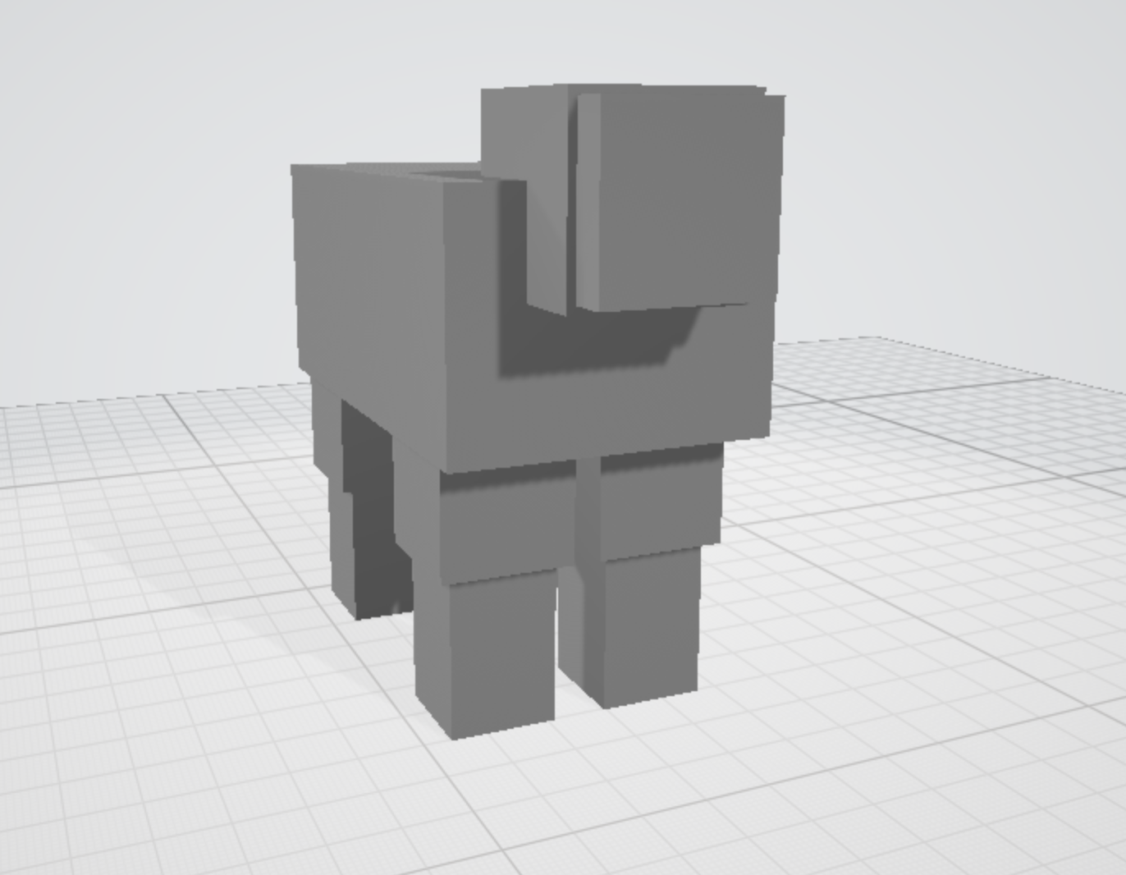
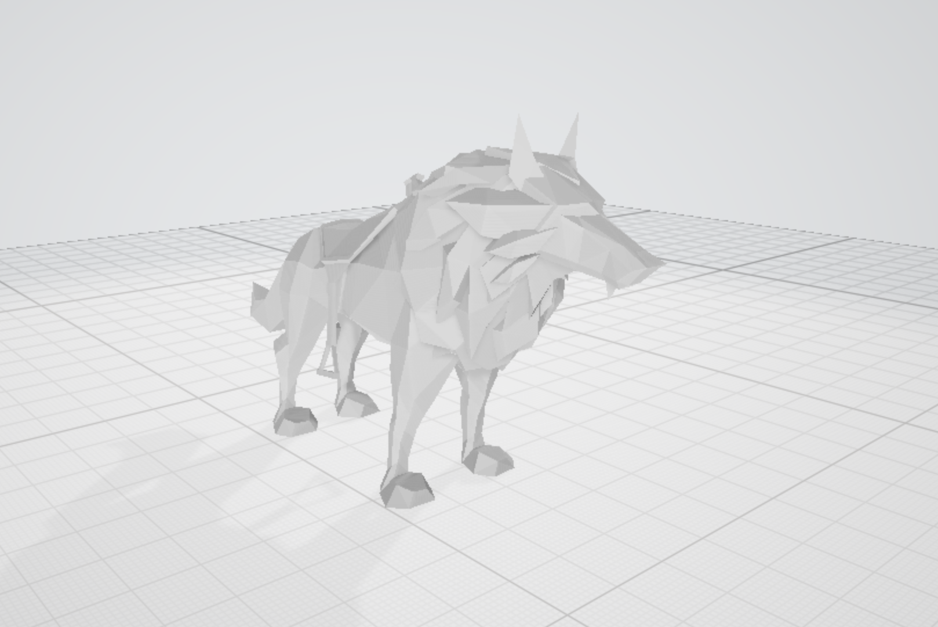
The structure of 3d Ecosystem
Environment
Producer
Consumer
Map
Sheep
Wolf
。

Slide 4
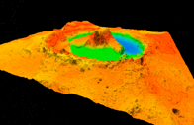

Slide 5
The important parameter for population
The number of biological born in a certain period of time
The number of biological that out migrate to the environment in a certain period of time
BIRTH RATE
DEATH RATE
Features determine population
IMMIGRATION RATE
OUTMIGRATION RATE
The number of biological deaths due to various reasons in a certain period of time
The number of biological that immigrate to the environment in a certain period of time

Slide 6
The Life of A Wolf
Create a new Wolf
Find couple and birth baby if not hungry
Frequency based on the Birth Rate
Get Birth
Hunt for sheep
Find Couple
Die
If can’t hunt prey, DIE.
frequency based on Hunt Rate
After age is bigger than a number, DIE
Based on Death Rate

Slide 7
The Life of A Sheep
Create a new Sheep
Find couple and birth baby if not hungry
Based on the Birth Rate
Get Birth
Wait for be hunted
Find Couple
Die
Wait for be hunted by wolf
After age is bigger than a number, DIE
Based on Death Rate

Slide 8
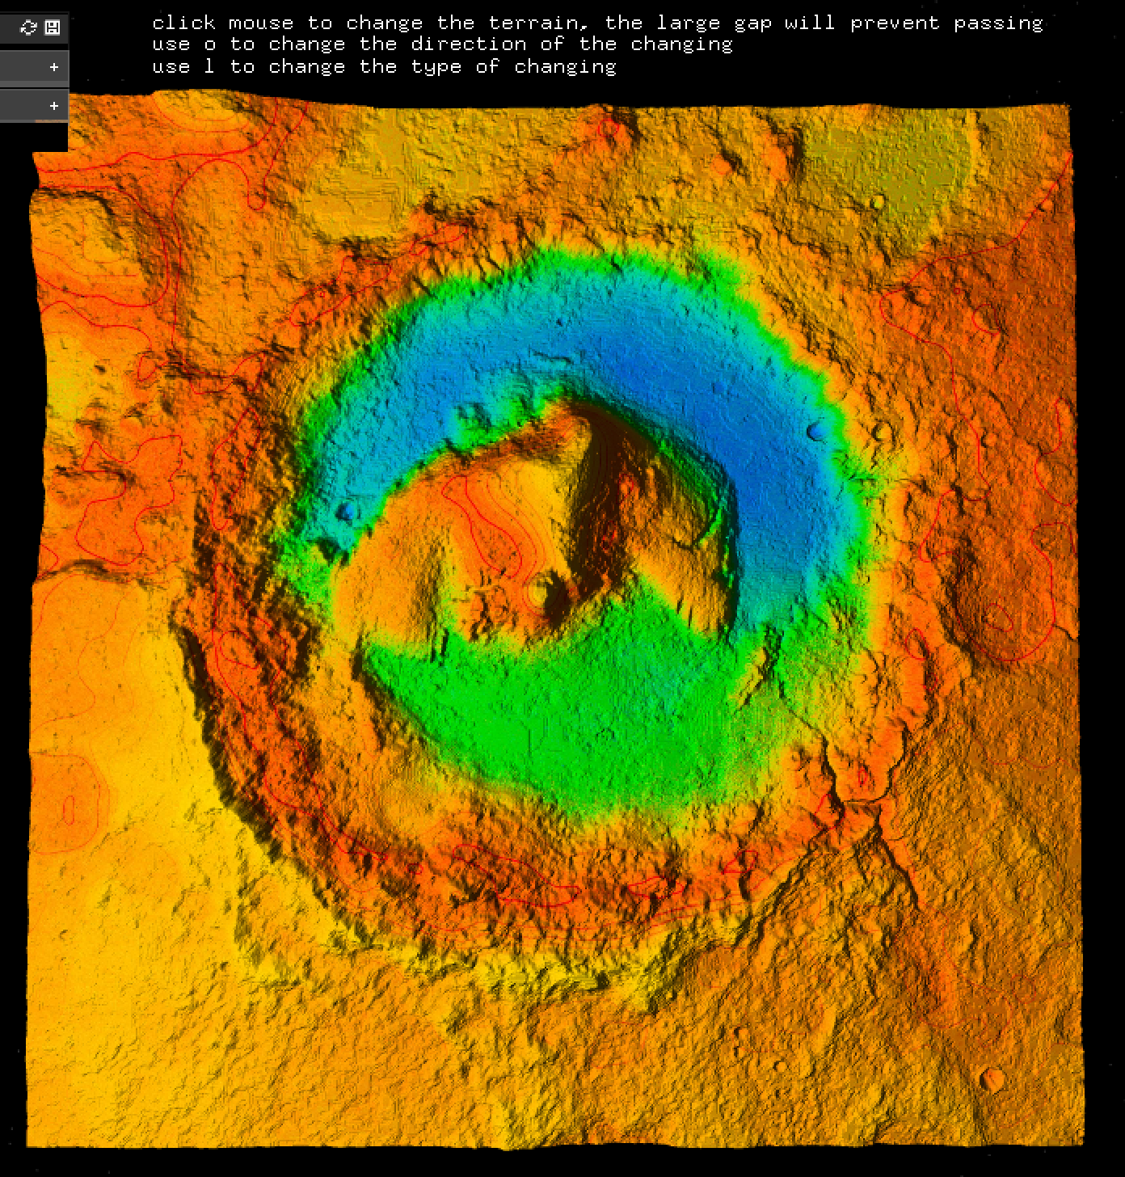
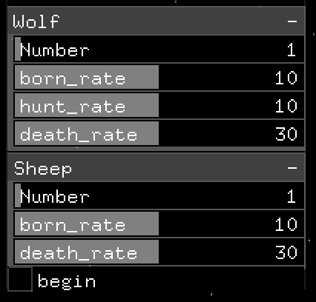
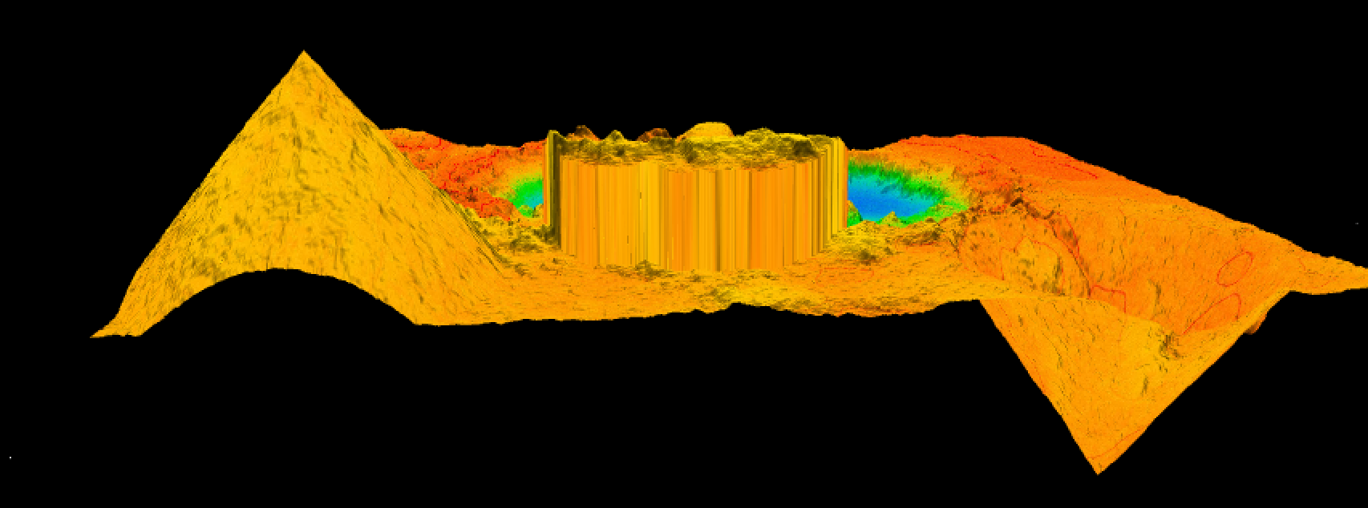
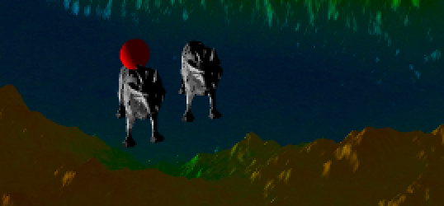
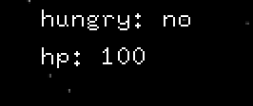
Interaction

Slide 9

That’ s all
thank you for watching and listening

